Slide 1
Upper Midwest Grazing Educators Webinar Series
Teaching the Basics of Grazing
May 15, 2015

Slide 2
Hosted by Warren King and Jane Jewett
Co-manager of the Pasture Project
President of WellSpring, Ltd
Work focused on expanding environmentally sustainable farming, developing local & regional food systems and improving water quality
Research Fellow, University of Minnesota
Green Lands Blue Waters Initiative

Slide 3
Webinar Technical Orientation
Notes:
Welcome! This is a quick overview of the basic features of the cluster call software.

Slide 4
Your Starting Screen
Presentation
Control Panel
Notes:
Your screen should look something like this.

Slide 5
To Display Minimized Control Panel
Click the orange arrow button
Notes:
You’ll want access to your control panel during the presentation, so if it is minimized, click the double arrow button.

Slide 6
To Keep Control Panel Visible
Notes:
To keep the control panel visible, go to the View menu …

Slide 7
To Ask a Question
Type your question in the small box at the bottom of the Questions box.
If possible, specify which panelist(s) you are addressing with your question.
Press “Send”!
Notes:
To interact with the panelist(s) or tech support, use the Questions box. Most questions will be addressed after the formal presentation during the Q&A time, but if you need clarification on a point, or have technical difficulties, ask at any time.

Slide 8
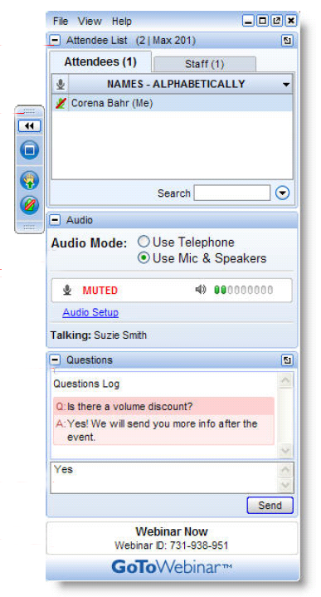
To “Raise Your Hand”
Notes:
To interact with the panelist(s) or tech support, use the Questions box. Most questions will be addressed after the formal presentation during the Q&A time, but if you need clarification on a point, or have technical difficulties, ask at any time.

Slide 9
Post-Webinar Survey
We will be sending out a survey following the webinar.
These surveys help to make for a better experience for everyone involved, if you could please take a moment to fill them out, it would be of great help to us.
Notes:
At the conclusion of the Cluster Call your browser will open showing a very brief survey. Please take a minute or two to fill it out so that we can continue to make the Cluster Calls a valuable service to you.

Slide 11
Who’s Sponsoring the webinar series?
Green Lands Blue Waters
The Pasture Project
Goals
Increase perennial forage and pasture
Improve environmental performance of farming
Maintain production and profitability
Goals
Expand grass-based livestock production
Accelerate transition to sustainable farm production
Improve water quality

Slide 12
Why Focus on Grazing Educators?
The Upper Midwest is a unique geography
More young farmers are interested in livestock production
More landowners and conservationist are interested in livestock benefits
More consumers want pasture raised meat and dairy products
Less public funding for grazing networks and education
Fewer professional development opportunities for educators
Changes in grazing techniques and terminology
No single source for education materials

Slide 13
What Could a Grazing Educator Network Achieve?
Connect Upper Midwest Educators through discussion and sharing
Assess education materials-tool; determine what’s missing and fill the gaps
Create a platform to house and access materials and tools
Share what works and why
Cross-pollination of staff, students, apprentices and programs
Involve established grazing education programs
Access materials-tools no longer in circulation
Build collaboration that is more “grass-roots” than “top-down”
Include educators of various types; farmers, academics, agency and consultants
Establish basic principles of managed grazing that are taught by all

Slide 14
What is the format for today’s webinar?
Presenters will discuss topics, sharing experience and insights
Audience is encouraged to do the same
Moderators will “direct the traffic” and keep discussion moving
Audience is asked to take a brief survey at the end of the webinar

Slide 15
Rhonda Gildersleeve
UW Extension Grazing Specialist Rhonda Gildersleeve has worked with agricultural producers in California and Wisconsin on profitable and environmentally sound grazing-based production systems for beef, sheep, and dairy cattle.
A native of Grant County, Wisconsin, Rhonda received a B.S. Agriculture in production agronomy from UW-River Falls, and also holds M.S. (University of Florida) and Ph.D. (Texas A&M University) degrees with emphasis on management of pasture and rangeland ecosystems.
In her spare time, Rhonda manages her own organic dairy farm near Boscobel, WI.

Slide 16
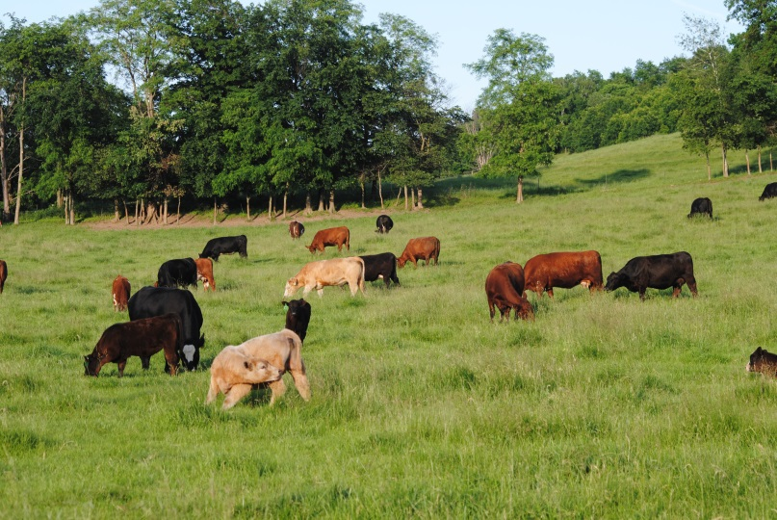
Use Livestock Husbandry Skills to Monitor the Grazing Animal
We have several tools available to monitor animal performance on pasture:
Production parameters: milk production, livestock weight gains, reproduction success, etc.
Body condition scores
Animal behaviors
Manure consistency

Slide 17
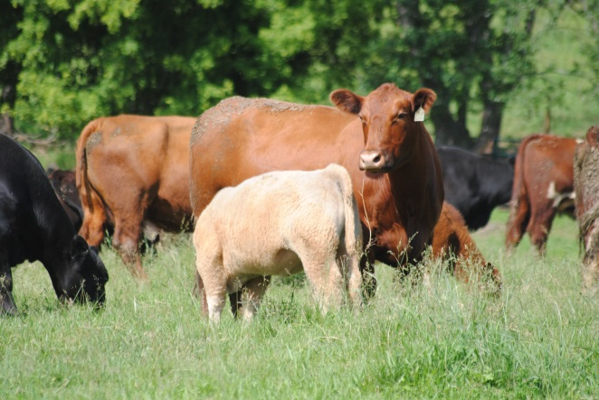
Grazing Animal Basics That We Need to Know
Definitions
Diet preferences
Digestive physiology
Nutrient needs of grazing livestock
Dry matter intake (DMI) factors
Relationships with pasture management

Slide 18
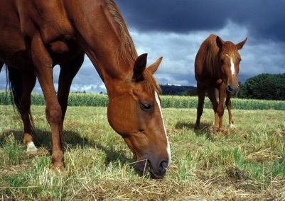
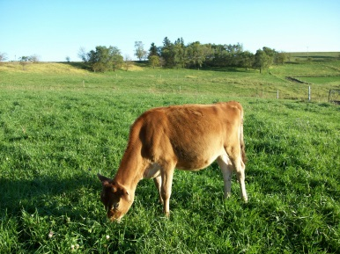
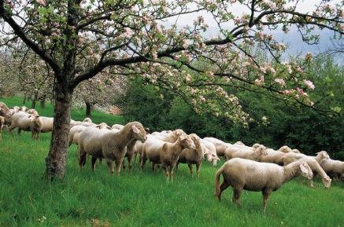
Definitions
Grazing animals co-evolved with their natural diets and developed digestive systems to optimize their food resources
Herbivores: plant-based diets
Ruminants: type of herbivore that has a 4 compartment stomach designed for “batch-processing” forages (cattle, sheep, goats)
Some herbivores are not ruminants (swine, horses)

Slide 19
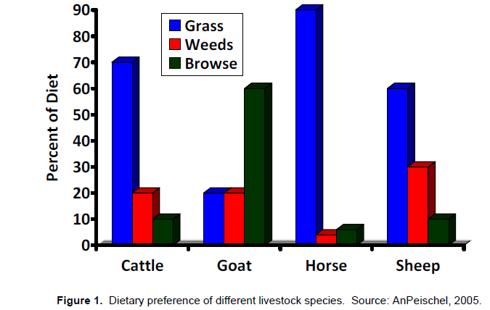
Herbivore Diet Preferences:
Grazers: primarily grasses (< 25% browse)
Browsers: primarily woody plant foliage, shrub/forb stems and leaves (<25% grasses)
Intermediates: switch hitters who adjust to available food supply

Slide 20
Ruminant: Any hoofed animal that digests its food in two stages
Ingests forage
Regurgitates semi-chewed forage (cud)
Chews cud
Ingests cud
Ruminants evolved to consume cellulose-based roughages
Consume forages rapidly and complete chewing process later
Digestive system includes a fermentation process by microbes that converts fiber to useable nutrients

Slide 21
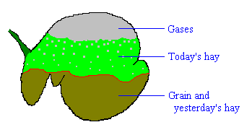
Ruminant Physiology
Think of rumen as a fermentation vat “on the hoof”
Microbes use fermentation process to break down complex carbohydrates (CHOs) such as cellulose to glucose, then convert to volatile fatty acids (VFAs)
Higher fiber in diet stimulates saliva production, which in turn increases VFA production
Ruminants get >70% of their energy from VFAs:
acetic, proprionic and butyric acids
Virtually all VFA absorption occurs in rumen

Slide 22
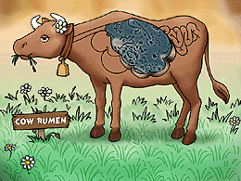
Ruminant Physiology
“When Microbe-Mama Ain’t Happy, Ain’t Nobody Happy”
Ideal environment: 100 - 108°F; pH = 6.0 – 6.4
Diet must meet the needs of both livestock and rumen bugs for energy & protein
Pastures are a good protein source for rumen microbes
Microbes themselves are the major protein source for ruminants once digested and absorbed in abomasum and small intestine.
Overfeeding energy results in a swift drop in pH, shifting rumen microbial populations, results in acidosis if rumen pH drops far below 6.2, shutting down fiber digestion

Slide 23
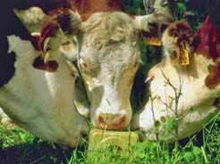
Nutrients Needed by Grazing Animals:
Water:
Crude Protein:
Content and digestibility of protein is generally adequate to high in managed pasture systems, but need adequate energy to utilize
Energy:
In pastures, CHOs are the primary energy source:
Non-structural CHOs: soluble sugars and starches: readily digested energy
Structural CHOs (fiber): cellulose, hemicellulose, lignin
Lignin is basically 100% indigestible, even by the rumen microbes
More mature plants = higher lignin content = lower digestibility
Species | Gallons /day
Beef cattle | 6 - 18
Dairy cattle | 10 - 30
Sheep, goats | 1 - 4
Horses | 8 - 12
Salt & Minerals:

Slide 24
Prioritization of Energy & Protein by Grazing Animals
Digestible Energy
Stressors: weather, parasites, disease, etc. Limit losses to these!
Maintenance
As animals get heavier, maintenance requirements increase
Reproduction
Lactation/ Growth
As production level increase, nutrient requirements increase
Storage
Adapted from Holecheck & Stuth, Grazing Management

Slide 25
What is Our Goal?
Depends on Class of Livestock & Production Goals

Slide 26
Beef Cow Cycle and Nutrient Demands
TDN, lbs. per day
.
Months from Calving
Nutrient demands change dramatically during annual livestock production cycle
MATCH livestock nutrient demands with pasture production and quality cycles
Notes:
Pasture line is based on relative forage availability not quality per se
CP and NE requirements roughly follow same pattern as TDN

Slide 27
What Grazing Animals Eat Is a Function of:
Dry Matter Intake
Time Spent Grazing range is 4 - 10 hours
Limited forage: need to graze for longer periods
Ruminants need almost equal amounts of time for grazing, rumination and rest
Biting Rate: how fast? range is 30 - 80 bites/minute (cattle)
Bite Size
how much an animal can consume in one bite
Only intake factor we can control with grazing management!
Our Goal:
Maximize bite size of high quality forage with few bites per plant to balance plant/animal needs

Slide 28
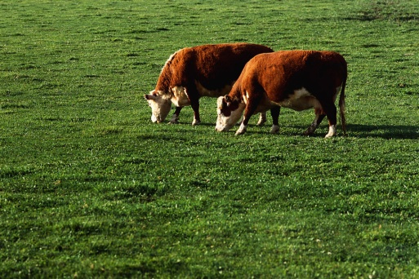
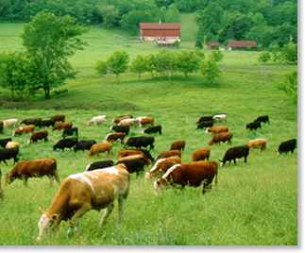
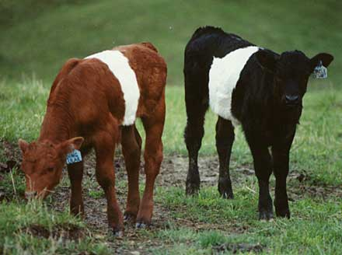
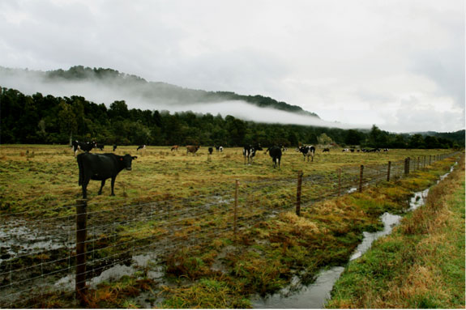
Pasture Dry Matter Intake Factors:
Palatability: how acceptable the forage “tastes” to the grazing animal
Nutritive value: amount of nutrients provided and how digestible they are
Availability: how much forage is offered
Our Goal: Maximize Pasture Dry Matter Intake to optimize animal performance

Slide 29
What is “Good” Dry Matter Intake (Cattle)?
Intake as a Percent of Live Weight | Expected Gains, pounds
2.0% | 1.0
2.5% | 1.5
3.0% | 2.0
3.5% | 2.5
“More is Better”

Slide 30
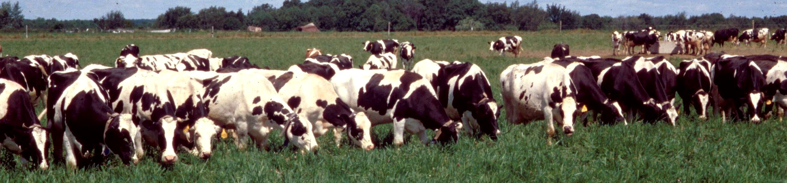
Managing Pasture for High DMI?
Grazing animals will always select the highest quality diet possible from the pasture forage available to them
Challenges:
Too little forage available — limits dry matter intake
Too mature — limits nutritive value of dry matter intake and slows rate of passage

Slide 31
Pastured Livestock Resources:
NRCS Pasture & Range Handbook: Chapter 6, Livestock Nutrition, Husbandry & Behavior, http://www.nrcs.usda.gov/wps/portal/nrcs/detail/national/landuse/rangepasture/?cid=stelprdb1043084
ATTRA: Ruminant Nutrition for Graziers, https://attra.ncat.org/attra-pub/summaries/summary.php?pub=201
Pasture-based Livestock Production, NRAES 187 (4 book series) Plant & Life Sciences Publishing, Cornell University, http://palspublishing.cals.cornell.edu/nra_order.taf?_function=view&ct_id=24
eXtension: http://www.extension.org/ and your local/state Extension Service for resources on related grazing & livestock production topics
Utah State BEHAVE website: https://extension.usu.edu/behave/ (grazing animal behavior information)

Slide 32
Allen Williams
Allen Williams is a 6th generation family farmer (since 1840) and founding partner of Grass Fed Beef, LLC and LMC, LLC. He has consulted with more than 3500 farmers and ranchers in the U.S., Canada, Mexico, and South America on operations ranging from a few acres to over 1 million acres.
Allen pioneered many of the early grass fed protocols and forage finishing techniques and has spent the last 15 years refining those. He is a “recovering academic” and has authored more than 300 scientific and popular press articles.
He is featured in the Carbon Nation film, “Soil Carbon Cowboys” (http://vimeo.com/80518559) and has a recently released book co-authored with Teddy Gentry, “Before You Have A Cow”.
Allen is a regular contributor to “GRAZE” and has written articles for the “Organic Broadcaster”, “Stockman GrassFarmer”, and many other publications.
He currently serves on the Board of Directors of the Grass Fed Exchange and the Mississippi Sustainable Agriculture Network, Core Team Member of the Pasture Project, and Co-Investigator for Team SoilCarbon. He also serves as an officer in the Starkville Civitan Club and is active in his local church.

Slide 33
What Are The Goals For Your Farm or Ranch?
Animal Performance vs. Soil Health
Are they antagonistic?
Can you achieve both at the same time?
What “cycle” do you want to be in?
Inorganic fertilizer, Lime, Herbicide cycle
Well-managed Water, Mineral, Energy Cycle
Can livestock be used effectively as a land improvement tool?

Slide 34
What Are The Limits to Building Soil Health?
How rapidly can we build Soil OM?
How much can we influence soil microbial populations and soil organism populations?
What influence do these have on forage productivity and quality, water infiltration & quality, and animal performance?

Slide 35
Building Soil OM – How Long Does It Take?
Mississippi – 1.0% - 4.2% (4 years)
New York – 1.5% - 4.1% (5 years)
Kansas – 1.6% - 3.9% (5 years)
Nebraska – 2.1% - 5.5% (6 years)
Michigan – 2.2% - 6.1% (6 years)
Wisconsin – 2.3% - 5.0% (4 years)
North Dakota – 1.6% - 11.0+% (12 years)

Slide 36
Soil Carbon Data – Total Soil Carbon
Horizon | AHSD | CG - Good | CG - Poor
1 | 4.67 | 1.64 | 1.36
2 | 4.00 | 1.88 | 1.37
3 | 2.95 | 1.03 | 0.40
4 | 2.04 | 1.02 | 0.54
5 | 1.71 | 0.38 | 0.40
6 | 1.42 | 0.41 | 0.34

Slide 37
Soil Carbon Data – Soil Organic Matter
Horizon | AHSD | CG - Good | CG - Poor
1 | 4.26 | 3.28 | 2.72
2 | 3.22 | 3.76 | 2.74
3 | 3.10 | 2.06 | 0.80
4 | 2.98 | 2.04 | 1.08
5 | 2.80 | 0.76 | 0.80
6 | 1.98 | 0.82 | 0.68

Slide 38
Soil Microbial Populations
Total Living Microbial Biomass (TLMB) – ng/g
2368 ng/g to 8756 ng/g (4 years)
986 ng\g to 7342 ng/g (5 years)
1987 ng/g to 11234 ng/g (6 years)
2198 ng/g to 9432 ng/g (5 years)

Slide 39
Forage DM Yield in High vs. Low Microbial Activity Fields
Variable | High Microbial Activity | Low Microbial Activity
Dry Matter (lbs/ac) | 8573 | 2559
Crude Protein (%) | 11.9 | 7.9
TDN (%) | 69.4 | 55.7
Source: USDA NRCS Mandan, ND.

Slide 40
Effects of Stage of Maturity on Pasture Composition
7
33
Protein
3
Lipid
25
10
Sugars
10
5
Minerals
Sweet Spot
23
12
Hemicellulose
14
30
Cellulose
18
3 Lignin 7
Early Maturity
Mid Maturity
Late Maturity

Slide 41
Forage Sequence Options
for Year Round Forage
Winter annuals (small grain/ annual ryegrass)
Warm season perennial grasses
Relative Growth Rate
Cool season perennial grasses
Warm season annual grasses
Spring oats and
brassicas
Jan | Feb | Mar | Apr | May | Jun | Jul | Aug | Sep | Oct | Nov | Dec
Percentage of each species will vary relative to yield

Slide 42
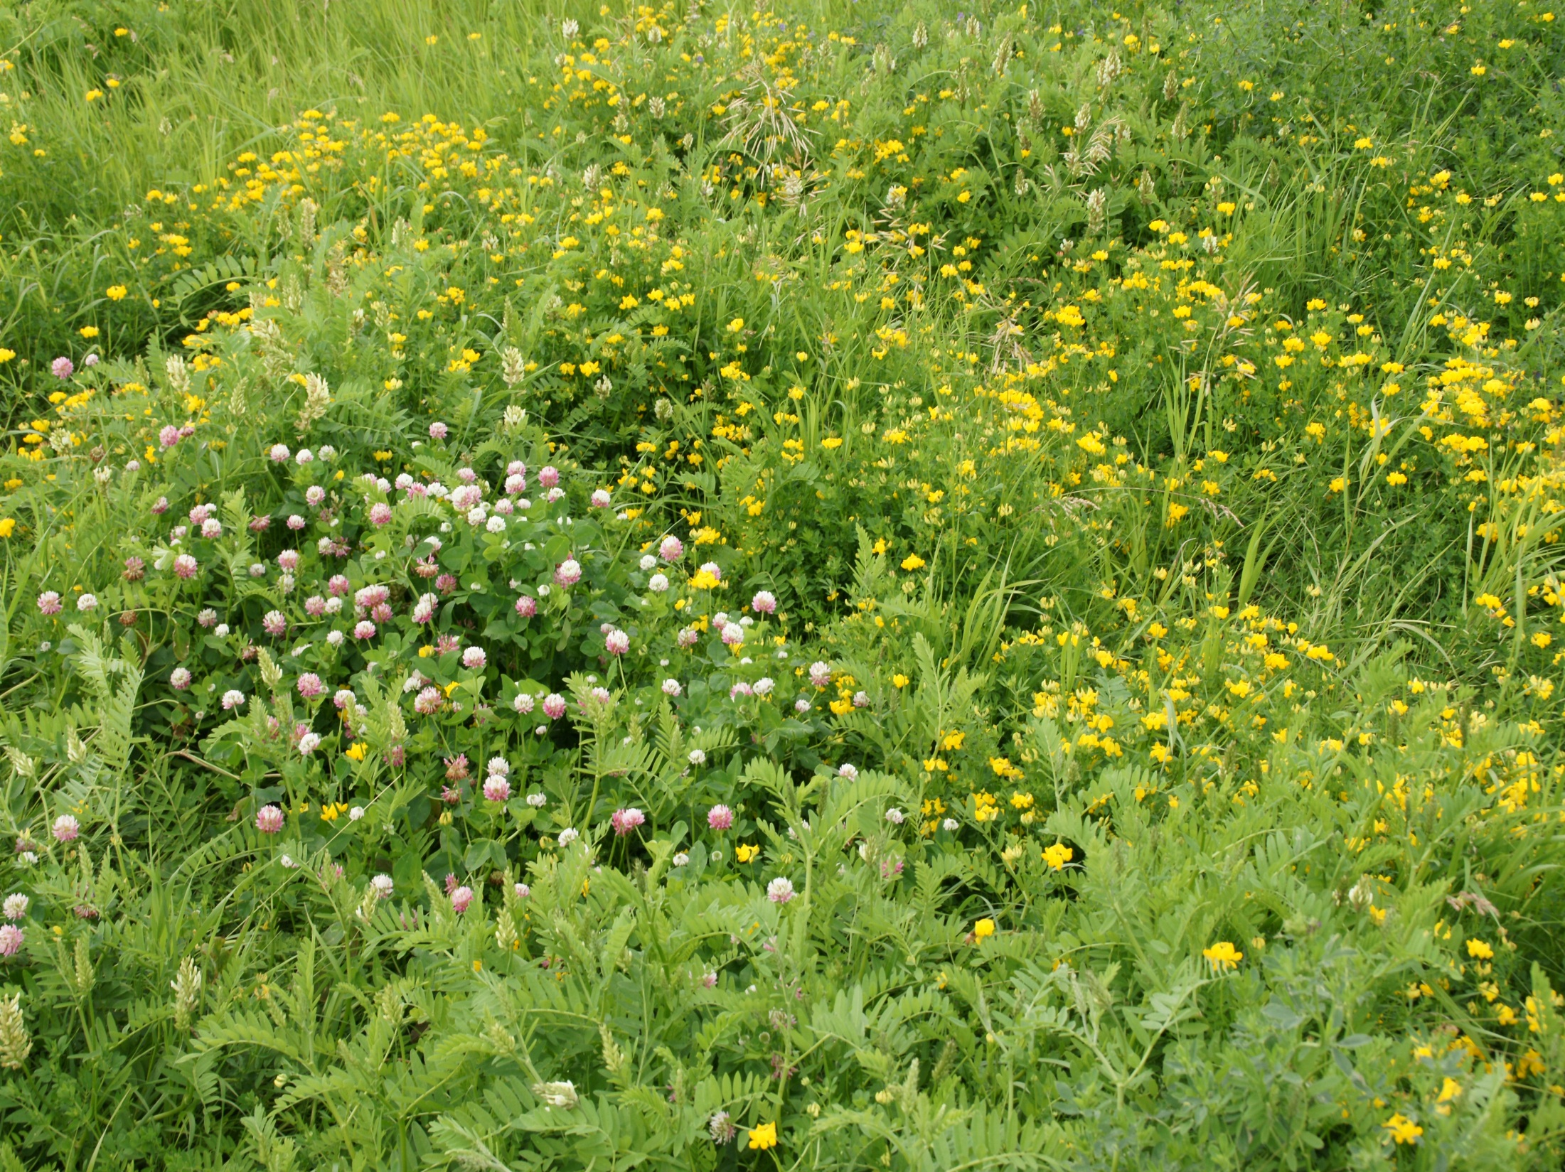
Diversity & Complexity Is Key

Slide 43
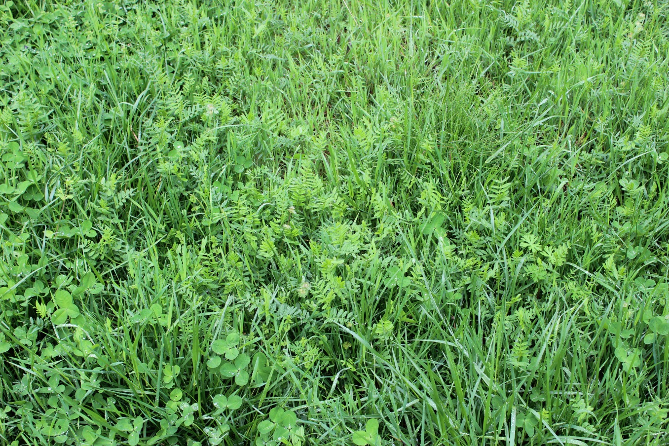
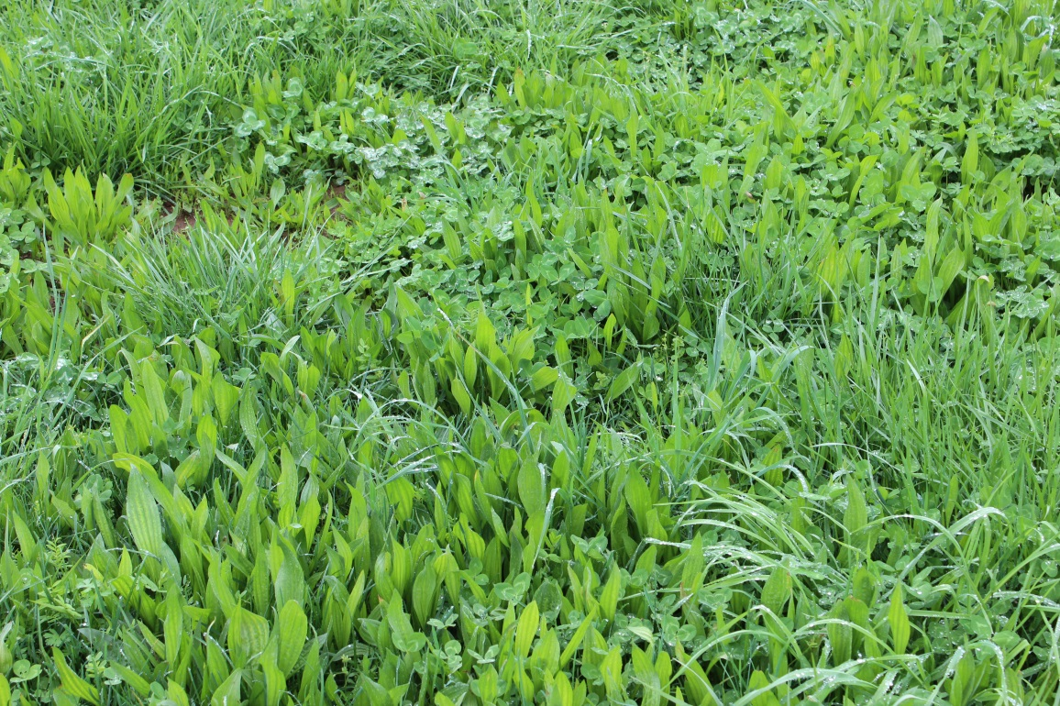

Slide 44
Recommended Forage Types
Good Mix of:
Grasses – Warm (C4) and Cool (C3) Season
Perennials and Annuals
Legumes – Clovers, medics, trefoils - Vetches, alfalfa, lespedeza, winter pea, cow pea, mung bean, etc…
Forbs – Herbaceous broadleaf plant that is not a grass or grass-like – Plantains, Docks, Dandelion, chicory, comfrey, small burnet, sunflower, etc.
Can include:
Brassicas – mustards, biennials.

Slide 45
Measures of Forage Quality
Plant Tissue Analysis
CP – Rumen Degradable and Bypass Proteins
TDN – Total Digestible Nutrients
ADF - estimates digestible dry matter (DDM) content
NDF - estimates potential dry matter intake (DMI)
NEm, NEg, Nel – Net Energy
RFV vs RFQ – Feed Value vs Forage Quality
WSC and NSC – Simple sugars, starch, fructan
Plant Brix

Slide 46
What to Use?
What is most efficient, effective?
What is cost? In $$ and time?
What are you measuring? What are you grazing?
What can producers most understand and implement?
To be effective a measure of forage quality must be low cost, easily measurable, observational, and implementable on a daily basis.

Slide 47
BRIX
Dissolved plant solids include sugars (such a sucrose and fructans), minerals, amino acids, proteins, lipids and pectins.
About 50-80% of the Brix measurement represents plant sugars, with the remaining portion representing the other plant solids.

Slide 48
What is a Refractometer?
A simple optical instrument that measures that amount of light refracted in a liquid.
Standard piece of equipment for many agronomists and commonly used in the fruit and vegetable industries.
Digital
Optical

Slide 49
Why High Brix in Forages?
Research shows that High Brix forages increase animal gains and milk production.
High Brix Forages also are more drought resistant, freeze tolerant, and more resistant to plant disease and pests
(Moorby, 2001).
(Moller, 1996).
(Downing & Gamroth, 2007; Miller, et al, 1999).
(Allison, 2007).
(McKenzie, 2007).

Slide 50
Brix Advantage
Brix 5.0% or less = ADG in low 1’s.
Brix 8-12% = ADG in low to mid-2’s.
Brix 12 – 15% = ADG in mid-high 2’s.
Brix > 15% = ADG in high 2’s to 3’s.
Every 1.0% increase in Brix adds 0.1 to 0.3 ADG.

Slide 51
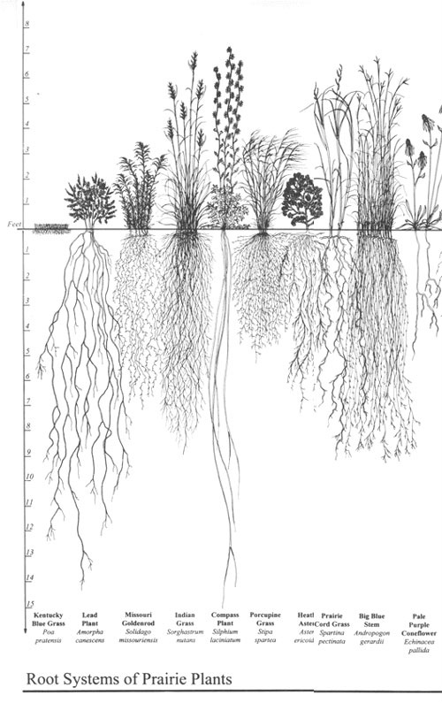
Monoculture
Diversity/Complexity

Slide 52
Kent Solberg
Kent currently serves as the Livestock and Grazing Specialist for the Sustainable Farming Association.
Kent and his wife Linda own and operate a grass-based livestock farm near Verndale, MN.
Kent has been involved in planned grazing and pasture based livestock systems 25 years.
For the past 7 years he has used cover crops and seeded annuals to extend the grazing season and improve soil health.
He has taught college courses and presented at numerous workshops on forages, fencing, grazing, soil health and livestock management.

Slide 53
Improving Pastures
Reduce occupancy duration
Increase length of rest periods
Tap into the power of the latent seed bank and animal impact.
“Plant fence posts first!”
Fertilizer, inter-seeding, reseeding

Slide 54
Pasture Goals = What are you trying to accomplish?
Landscape = soil and plant community health and vigor
Animal performance
May need to focus on landscape first to meet ultimate goal of animal performance
Limits (stocking rates) – soils, climate
Balance needs of animals with land capabilities.

Slide 55
Pasture forage types
Sod forming grasses
Kentucky bluegrass, smooth brome, quack grass
Bunch grasses
Orchard grass, big blue stem, meadow fescue
Legumes – nitrogen fixers
Alfalfa, clovers, birdsfoot trefoil
Strive for diverse pastures = soil and animal health, pasture productivity (ability to capture light).

Slide 56
Pasture Forage Types
Jointing grasses
Timothy, smooth brome, reed canary
Elevated growing points
Non-jointing grasses
Orchard grass, tall fescue, perennial ryegrass
Growing point at crown (ground level)
All cool season grasses grow only from crown in the spring.

Slide 57
Pasture forage types
Cool season grasses – orchard grass, smooth brome
60 - 77⁰ F
Warm season grasses
85 - 100⁰ F

Slide 58
How large a paddock?
50 jerseys @ 1000 #’s = 50,000 #’s
50,000 #’s x 3% BW = 1500 #’s DM/day
1500 #’s DM/day ÷ 1200 #’s/acre DM = 1.25 acres/day
Observe!
Residual heights
Livestock response – gain, milk production, rumen fill, activity, etc.
Adjust as necessary

Slide 59
Stocking Density = pounds of livestock on a given unit of pasture at one time (e.g. concentration)

Slide 60
Stocking Rate = total number of animals your pasture will support.

Slide 61
Available Forage
Collect your data:
Average forage height (inches)
Estimated dry matter in pounds/acre inch.

Slide 62
Available Forage
Example:
16” average forage height
Take 50%
8” available forage
8” available forage X 150 #’s/acre DM = 1200 #’s/acre DM

Slide 63
Pasture Forage Types

Slide 64
Pastured Livestock Resources:
NRCS Pasture & Range Handbook: Chapter 6, Livestock Nutrition, Husbandry & Behavior, http://www.nrcs.usda.gov/wps/portal/nrcs/detail/national/landuse/rangepasture/?cid=stelprdb1043084
ATTRA: Ruminant Nutrition for Graziers, https://attra.ncat.org/attra-pub/summaries/summary.php?pub=201
Pasture-based Livestock Production, NRAES 187 (4 book series) Plant & Life Sciences Publishing, Cornell University, http://palspublishing.cals.cornell.edu/nra_order.taf?_function=view&ct_id=24
eXtension: http://www.extension.org/ and your local/state Extension Service for resources on related grazing & livestock production topics
Utah State BEHAVE website: https://extension.usu.edu/behave/ (grazing animal behavior information)

Slide 65
Resources
www.attra.ncat.org
http://www.plantsciences.ucdavis.edu/gmcourse/module_resources/module4/Resources/readings/ruminant.pdf
http://forages.oregonstate.edu/nfgc/eo/onlineforagecurriculum/instructormaterials/availabletopics
http://forages.oregonstate.edu/nfgc/eo/onlineforagecurriculum/instructormaterials/availabletopics
http://forages.oregonstate.edu/nfgc/eo/onlineforagecurriculum/instructormaterials/availabletopics

Slide 66
Future Webinars

Slide 67
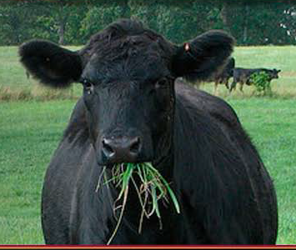
Thank you!

